Slide 1
Library Management System
LEON - N01541167
OLUWOLE - N01510754
SUSANT - N01550307

Slide 2
Roadmap
Brainstorm of ideias and concepts to be created
Feedback from Phase 1 based changes and final version of ER Diagram
SQL statements to display information
1
3
5
2
4
6
Phase 1: Conceptual design with an ER diagram using draw.io
Phase 2: ttranslating the ER diagram into a logical design
Checking Data consistency with Triggers

Slide 3
ER Diagram

Slide 4
$103.00
19 users
70
Total fine ‘Unpaid’
13 books borrowed, no overdues
Books available in 10 branches

Slide 5
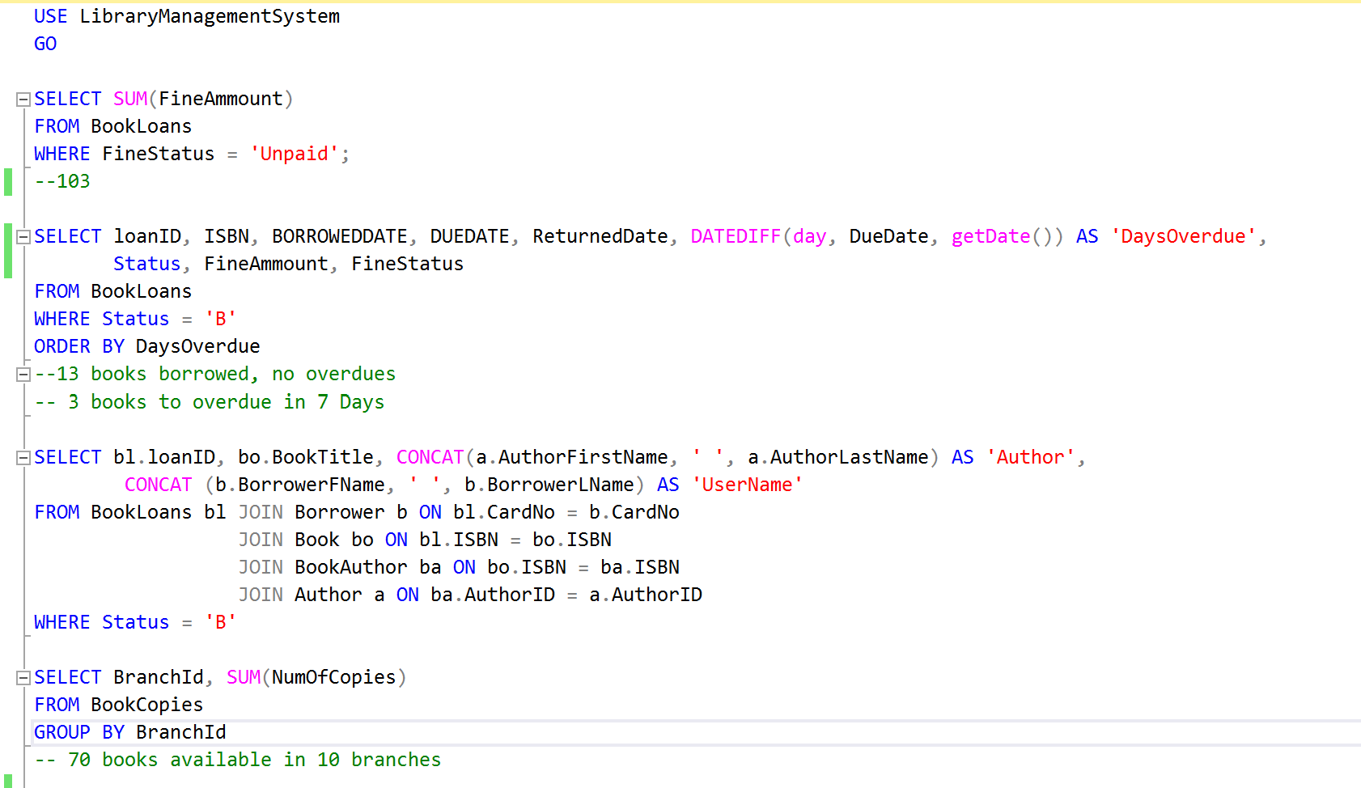

DML
Data Manipulation Language with SELECT statements to retrieve data.

Slide 6
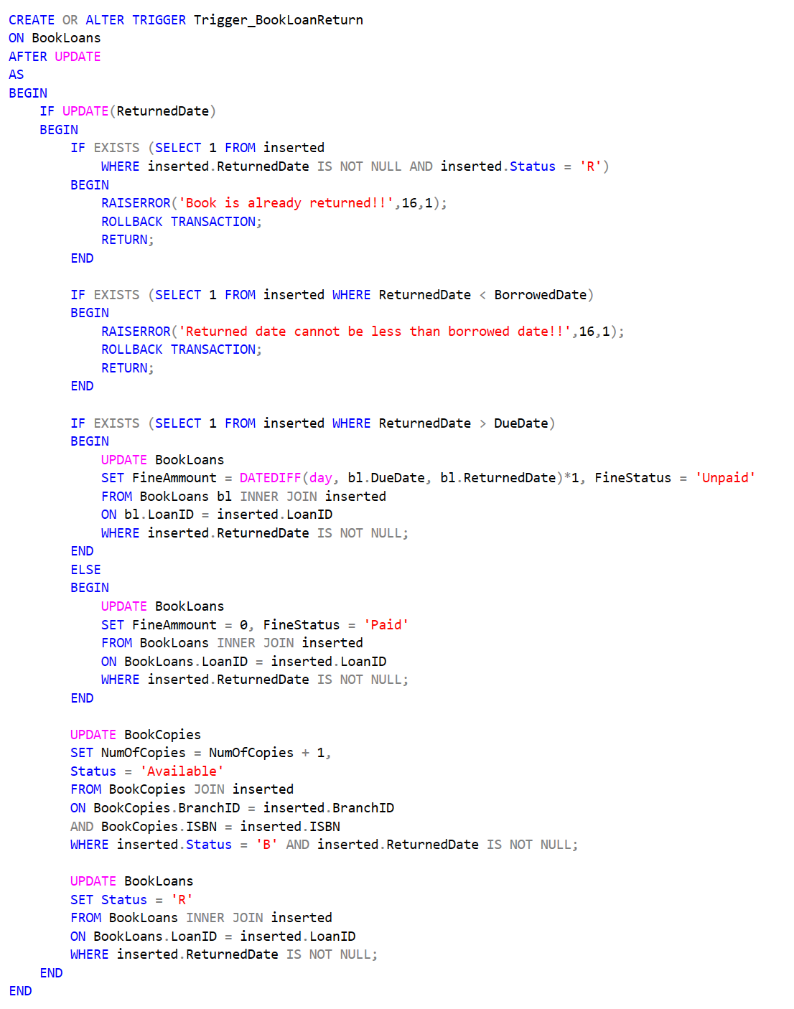
trigger_returnBook
Checks inserted
if status is not ‘R’
Checks inserted
if borrowed date > returnedDate
Update BookLoans
with/without fine
Update BookLoans
with status ‘R’
Update BookCopies
Inserting a copy to availability

Slide 7
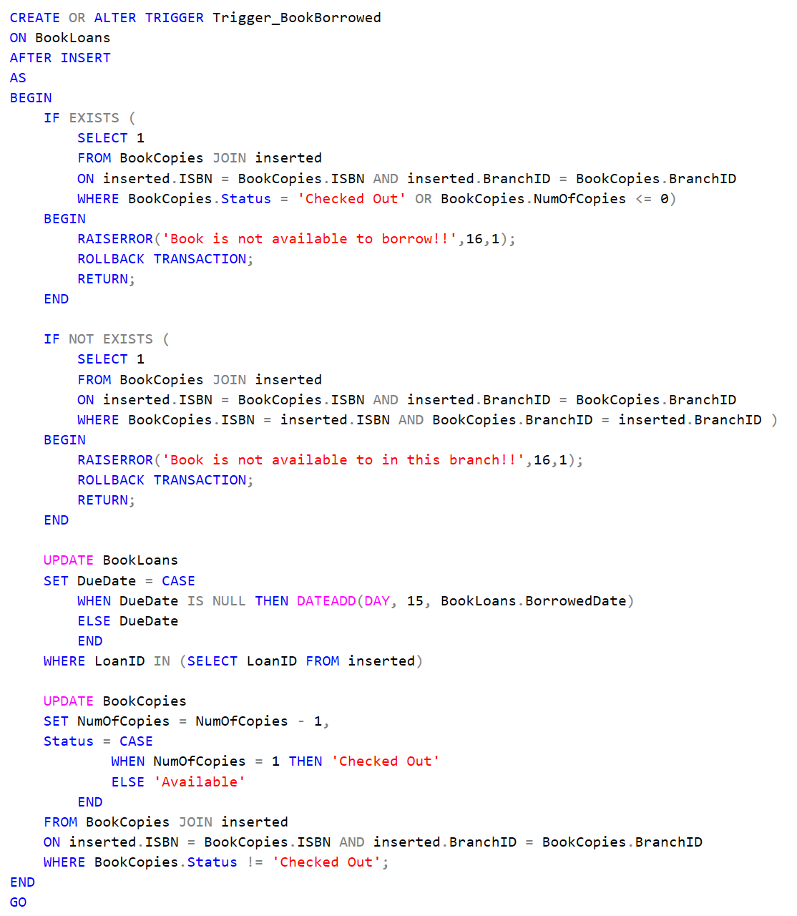
trigger_insertLoan
Checks BookCopies
if it is ‘Available’ or ‘Checked out’;
Checks BookCopies
if specific branch has copies available;
Update BookLoans
with BorrowedDate + 15 days;
Update BookCopies
reducing NumOfCopies;

Slide 8
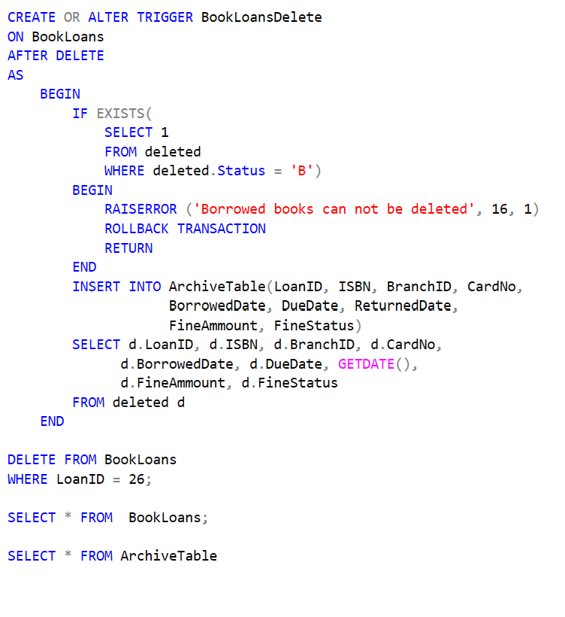
trigger_ArchiveTable
Checks deleted
if book is still status = ‘B’ and raise and error in case it is
Insert into ArchiveTable
LoanID, ISBN, BranchID, CardNO, BorrowedDate, DueDate, ReturnedDate, FineAmmount, FineStatus

Slide 9
In conclusion, this two-phase project successfully formalized an ER diagram into a robust, consistent SQL Server relational database schema, utilizing constraints and triggers.

Slide 10

Thanks!
Any questions?

